Slide 1



HEALTHIFY ME
REVOLUTIONIZING NUTRITION: PERSONALIZED, ENGAGING, AND EMOTIONALLY INTELLIGENT DIET SOLUTIONS

Slide 2

TEAM ELITERS
—
—
—
—
ASWINI
ASWIN KRISHNA
NITHYA SHREE G
YESWANTH S
M S
C P

Slide 3
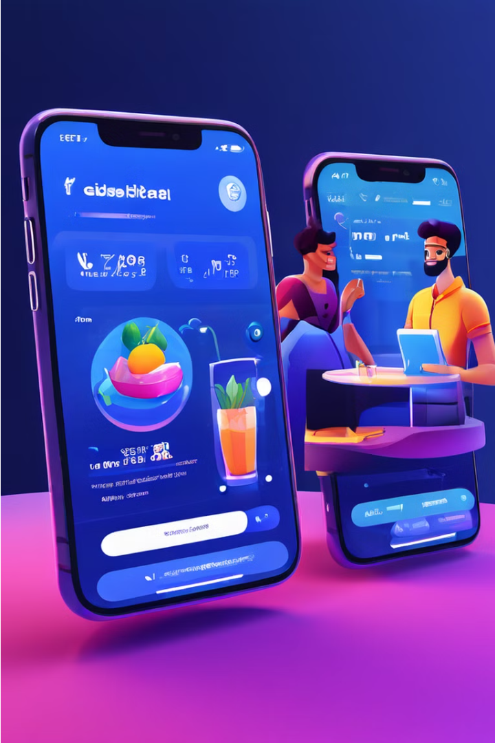
Problem Statement
Develop a health platform where users input dietary restrictions and allergies to receive customized recipes. Users can join a supportive community, form health groups for competitions, access nutritional info and diet plans, and attend expert-led webinars. Empower individuals with tailored support and resources to achieve their health goals.

Slide 4

Existing Solution
1
Track your daily food intake, calories, and essential nutrients for better nutrition management.
2
Customizable meal plans based on dietary preferences, restrictions, and health goals.
3
Alerts to remind users to eat, drink water, and log meals.
4
Tools for monitoring weight, calories consumed vs. burned, and overall progress towards health goals with visual charts and graphs.
5
Barcode scanning for quick and accurate logging of food intake.

Slide 5

Proposed Solution
1
Suggest safe and tasty food options based on the user's allergies and dietary restrictions.
2
Promote teamwork and motivation with fun family challenges and friendly competitions.
3
Offer recipes that match the user's current mood and preferences for a better eating experience.
4
Create diet plans tailored to individual health needs, using insights from DNA, gut bacteria, and expert advice to ensure optimal nutrition and health management.

Slide 6




Technology
Frontend Technologies
Backend Technologies
HTML
Python
CSS
Flask
JavaScript
Database
Mongo DB

Slide 7

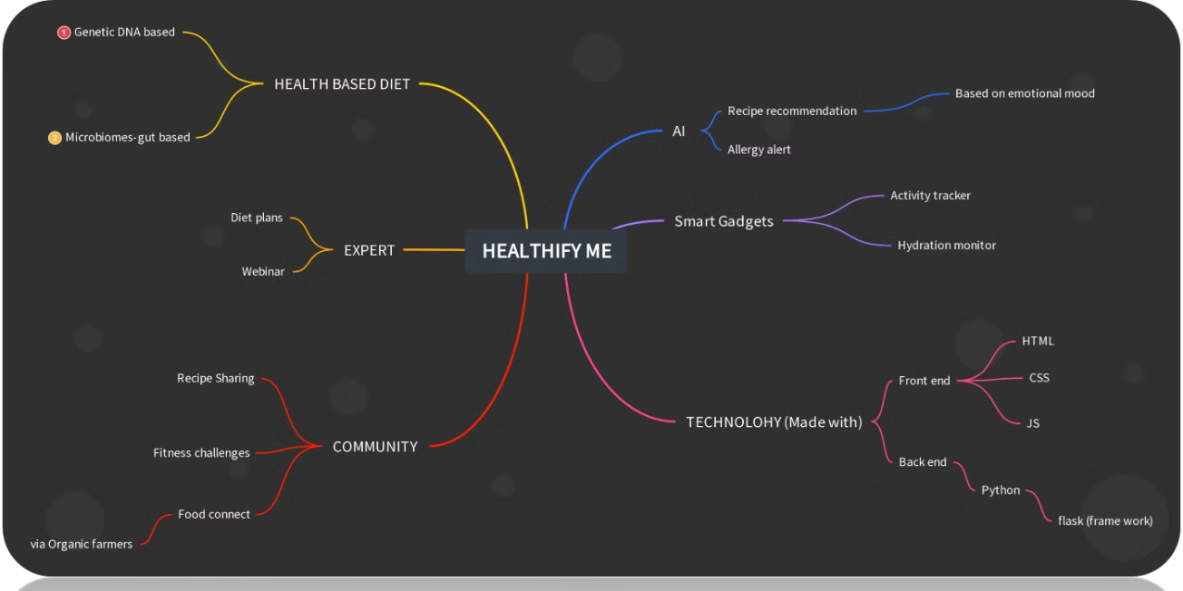
Mind Map

Slide 8
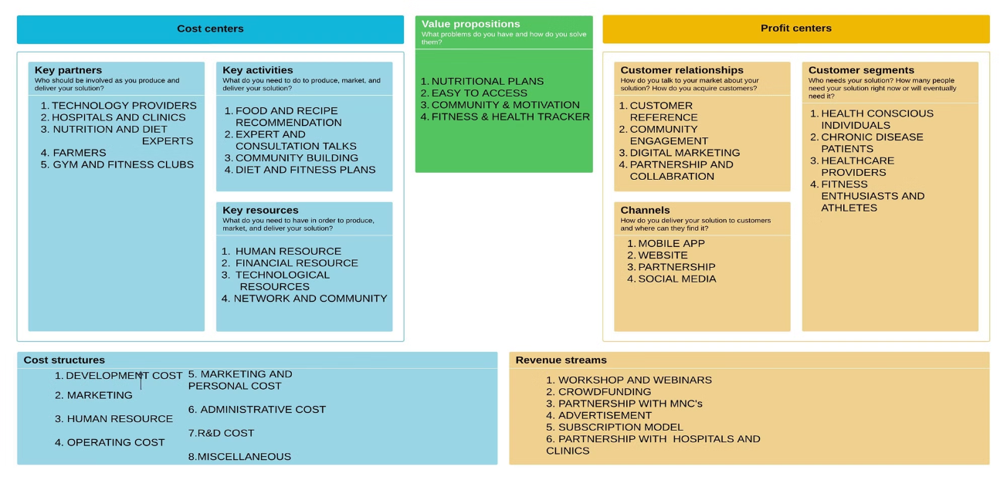
Business Model Canva

Slide 9

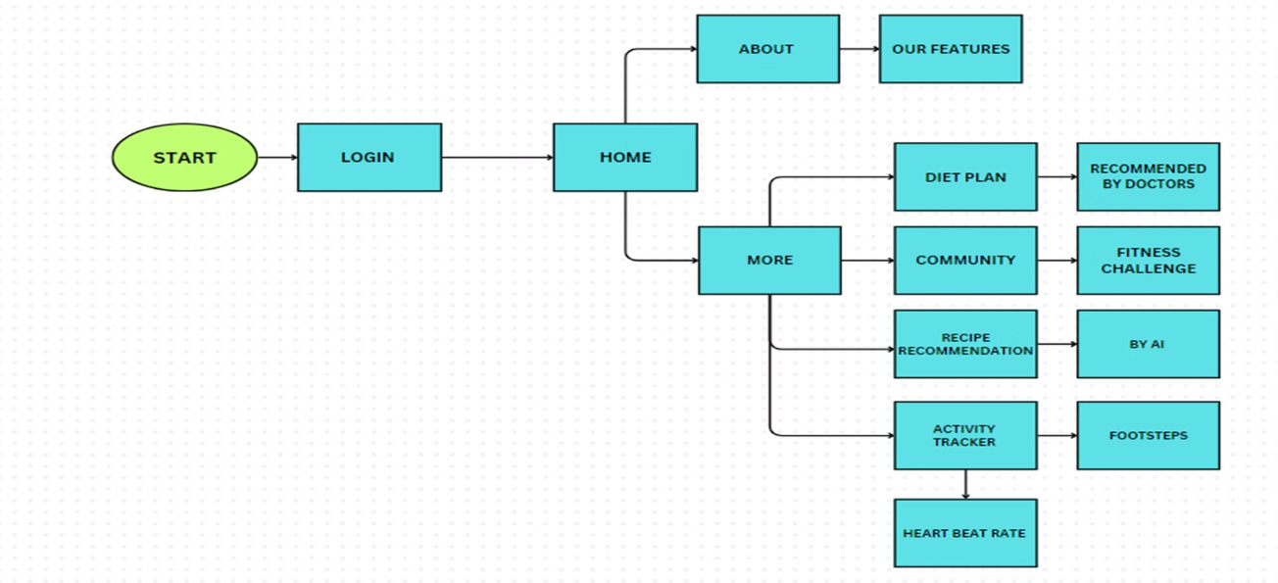
Block Diagram

Slide 10

Conclusion
Our project redefines health and family well-being by offering tailored food recommendations that consider allergens and dietary restrictions for safe and enjoyable meals. We engage families through challenges that promote bonding and healthy habits and provide real-time recipe suggestions that match moods and preferences. With expert-designed diet plans ensuring optimal nutrition, we create a holistic and enriching approach to healthier, happier lives.

